Slide 1

Knowledge sharing and agricultural innovation system model
Developing Knowledge-Sharing Partnerships in Europe and Central Asia
4-6 December 2013
Nevena Alexandrova, FAO REU
nevena.alexandrova@fao.org

Slide 2
Content
Why do we need to share knowledge
Agricultural innovations and AIS model- basic concepts
Knowledge, information and knowledge-sharing
FAO approaches- resources, tools and examples
Conclusions

Slide 3
Share your knowledge. It’s a way to achieve immortality.
Dalai Lama
(1357-1419, high lama in the Gelug school of Tibetan Buddhism)

Slide 4
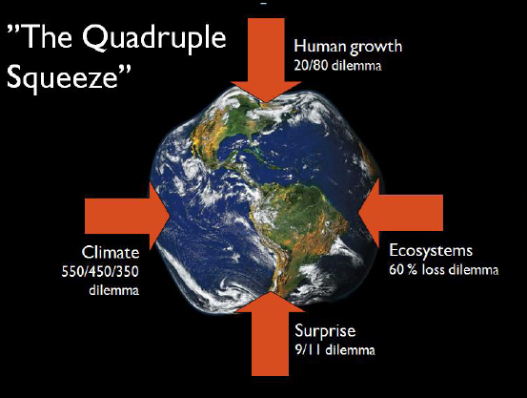
Source: UNEP 2011

Slide 5
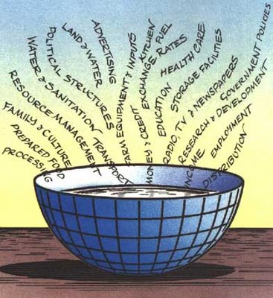
How to produce more with less?
Change in agricultural practices
Change in consumer preferences
Change of agricultural policies
Change in knowledge systems
Notes:
Conservation agriculture
5

Slide 6
Evolution in agricultural development
Markets, not production, increasingly drive agricultural development
Production, trade, consumption: more dynamic, evolving in unpredictable ways
Knowledge, information and technology, generated, shared & applied also through private sector
ICTs allow using knowledge created elsewhere or for other purposes
Knowledge structure (education level of various actors) of agricultural sector is changing
Agricultural development increasingly takes place in globalised setting

Slide 7
Evolution of agricultural knowledge systems
Until 1980: linear, top-down approach, research-extension-farmers (NARS)
In 90s: knowledge triangle: research- education-extension, private sector (AKIS)
Recently: non linear, participatory, dynamic, demand driven, networking (AIS)

Slide 8
The role of research in the innovation approach
Different roles of science in relation to decision-stakes and uncertainties
(From Functowicz and Ravetz, 1993)
Needs to acquire new skills –Communication, Facilitation,
Conflict management; Network brokerage, Demand articulation
Different roles of science in relation to decision-stakes and uncertainties
(From Functowicz and Ravetz, 1993)
Notes:
. In the introduction, it has been argued that climate change goes along with the emergence of complex problem situations. The same can be attributed to the controversy in the society at large about the use of genetically modified organisms (GMOs). This complexity issue has important implications for the role of scientists and research since different levels of complexity require different modes of operation by scientists. In ‘low complexity’ situations where both uncertainty and decision stakes are low (i.e., goals are not contested), Funtowicz and Ravetz (1993) argue, scientists can suffice to act as applied scientists and engage in ‘puzzle solving’. If uncertainty and stakes are moderate, scientists can act as consultants; scientific knowledge is then combined with context-specific expertise and tacit judgements. In case of high uncertainty and decision-stakes, scientists need to engage in post-normal science. They have to become intensely involved in societal interactions and collaborative forms of research in order to contribute to the development of shared views and value commitments. In order to make innovation happen in a network-like configuration to support network building, social learning and conflict management, the traditional communication and knowledge-sharing strategies should be expanded to include network brokerage, demand articulation, visioning, facilitation, and others

Slide 9
Agricultural innovation
Process of bringing new products, new processes and new forms of organization into social and economic use in which multiple actors learn and innovate, manage risks and share benefits.
Interactive process
Multiple actors
Networking
Focus on the impact in terms of development
Participatory approach
Pluralistic origin
Demand driven

Slide 10
Innovation systems concept
Definition
Drivers
A network of organizations, enterprises and individuals
focused on bringing new products, new processes and new forms of organization into social and economic use.
interactions with institutions and policies that affect their behaviour and performance.
Market
Environmental factors (Climate change)
Policy and legal frameworks
Science and technology
Infrastructure

Slide 11
Agricultural Innovation System
Agricultural Knowledge
& Information System (AKIS)
Exporters
Research
System
Agro-Processors
Producer
Organizations
Producers
Farmers
Input Suppliers
Advisory
Services
System
Education
System
Credit Agencies
Land Agencies
Modified from:
Birner et al. 2006
Government Policy & Regulatory Framework
Notes:
11
Agricultural extension operates within a broader knowledge system referred to as AKIS/RD (Agricultural Knowledge and Information Systems for Rural Development).
The three pillars of this system are research, extension and agricultural higher education – «the agricultural knowledge triangle»
Linking the triangle’s institutions with their common clientele, namely the farmers, and with each other, requires systematic planning.
Innovations are being focused on bringing new products, processes and forms of organization into social and economic use, which requires the active and interactive networking of all actors involved in agriculture. In innovation systems, networks of different players are transient and emerge around specific challenges and tasks at particular points in time. (World Bank, 2006).
The gears of agriculture innovation systems are often borrowed from other sectors and include the use of competitive funds for research and development; the establishment of public-private research consortia, typically around a particular commodity and at times on cross cutting issues (i.e. biotechnology, climate change); decentralized or regional level innovation platforms including all stakeholders; decentralized public and private delivery of extension services, often based on competitive funding for communities and for extension service providers; and others.

Slide 12
Organizations/individuals of an AIS Model
Demand
Consumers (food, agro-industrial)
Export markets
Policy-makers
Two way
IC flows for
innovation
Intermediaries
(service providers)
Extensionists
NGOs
Consultants
Private companies
Farmer & trade assoc.
Donors
Research
(producers of knowledge)
NARS & IARS
Universities & colleges
Private research foundations
Private companies
NGOs
Farmer organizations
Enterprises
(users of knowledge for
production/business)
Farmers
Traders
Input suppliers
Agro-processors
Transporters
Support structures
Financial system
Transport & marketing infrastructure
Professional networks, trade & farmer associations
Education system
(Arnold and Bell, 2001 modified)
Notes:
Summing up, the agricultural innovation system, compared to its ancestors, is the conceptual framework of knowledge that is in the position to provide, if the correct modus operandi is in place, the flexibility needed to ensure efficient and effective response to current and future challenges in the agricultural sector, e.g. climate change adaptation and mitigation, natural resource management and biotechnologies in agriculture. A key challenge is the adequate level of institutional and organizational development. The innovation system focus on network development assumes that these other organizations are already strong enough, while, in fact, this is still a challenging issue in the countries with economies in transition in Europe and Central Asia

Slide 13
Knowledge - sharing
Knowledge is “what is in people’s heads” in a form of “know-how” (including know-how, know-what, know-who, know- why and know-when) with can be shared through human interactions, e.g. networks and communities
Information vs. Knowledge: knowledge is information, which is perceived valuable by the receiver and could be put into practical use.
Knowledge-sharing is one of the primarily tools in FAO’s fight against hunger and is one cross-cutting element of the FAO Strategic Objectives.

Slide 14
Communication
Two-way process of reaching mutual understanding, in which participants not only exchange (encode-decode) information, news, ideas and feelings but also create and share meaning.
In general, communication is a means of connecting people or places.
Read more: http://www.businessdictionary.com/definition/communication.html#ixzz2ZrC5QqEs

Slide 15

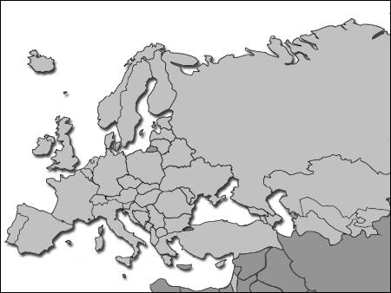
FAO Regional Office for Europe and Central Asia (ECA)
http://www.fao.org/europe/en/
FAO MEMBER COUNTRIES EUROPE AND CENTRAL ASIA
53 member countries
Albania, Andorra, Armenia, Austria, Azerbaijan, Belarus,
Belgium, Bosnia and Herzegovina, Bulgaria, Croatia, Cyprus,
Czech Republic, Denmark, Estonia, Finland, France,
Georgia, Germany, Greece, Hungary, Iceland,
Ireland, Israel, Italy, Kazakhstan, Kyrgyzstan,
Latvia, Lithuania, Luxemburg, Macedonia, FYR, Malta,
Moldova, Monaco, Montenegro, Netherlands, Norway, Poland,
Portugal, Romania, Russian Federation, San Marino, Serbia,
Slovakia, Slovenia, Spain, Sweden, Switzerland,
Tajikistan, Turkey, Turkmenistan, Ukraine, United Kingdom, Uzbekistan,
Member Organization: European Union.
Notes:
15
Regional Office for Europe was created in 70s with seat in FAO HQs in Rome. In 2007, as a result of decentralization processes aiming at better efficiency and improved response of the needs of the FAO Member countries, REU moved in Budapest, Hungary. Current Agricultural research and biotechnology officer began in December 2008.

Slide 16
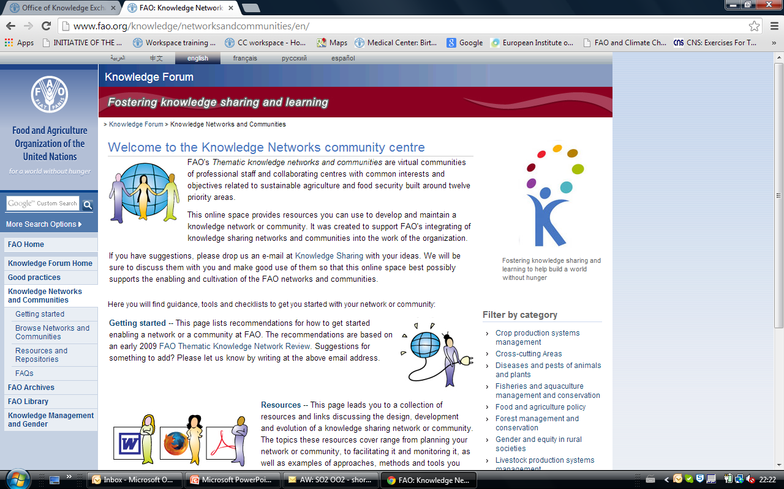

Slide 17
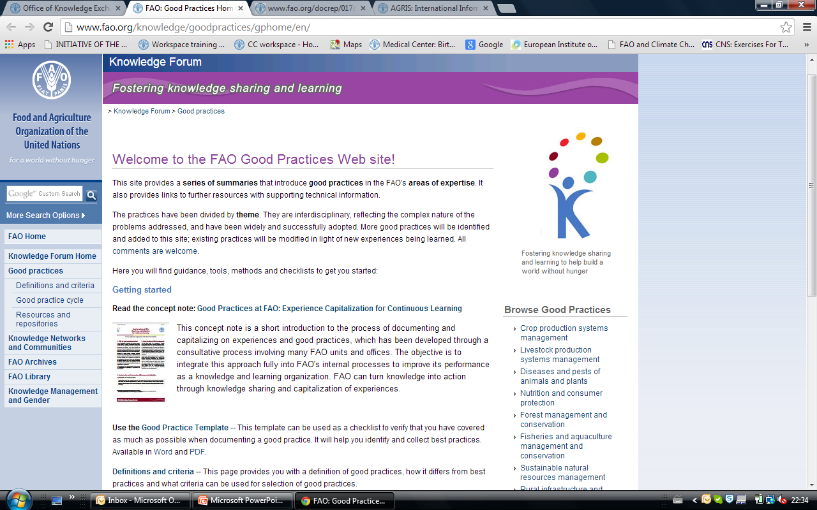

Slide 18
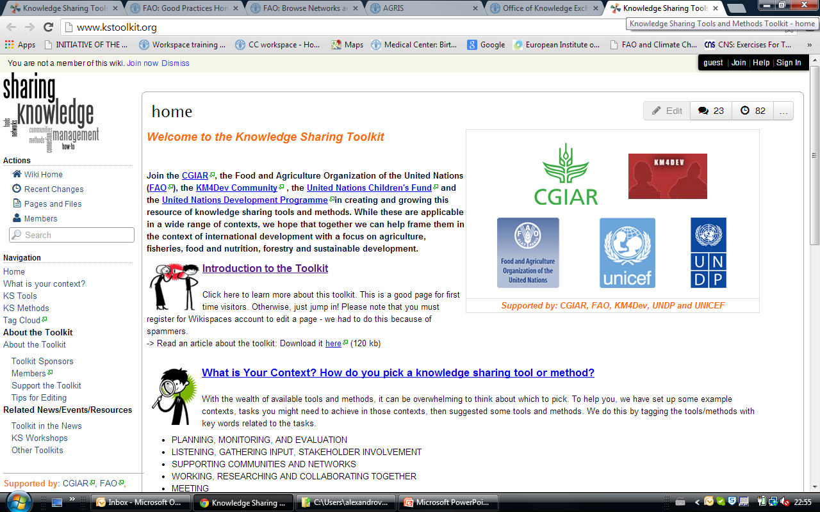

Slide 19
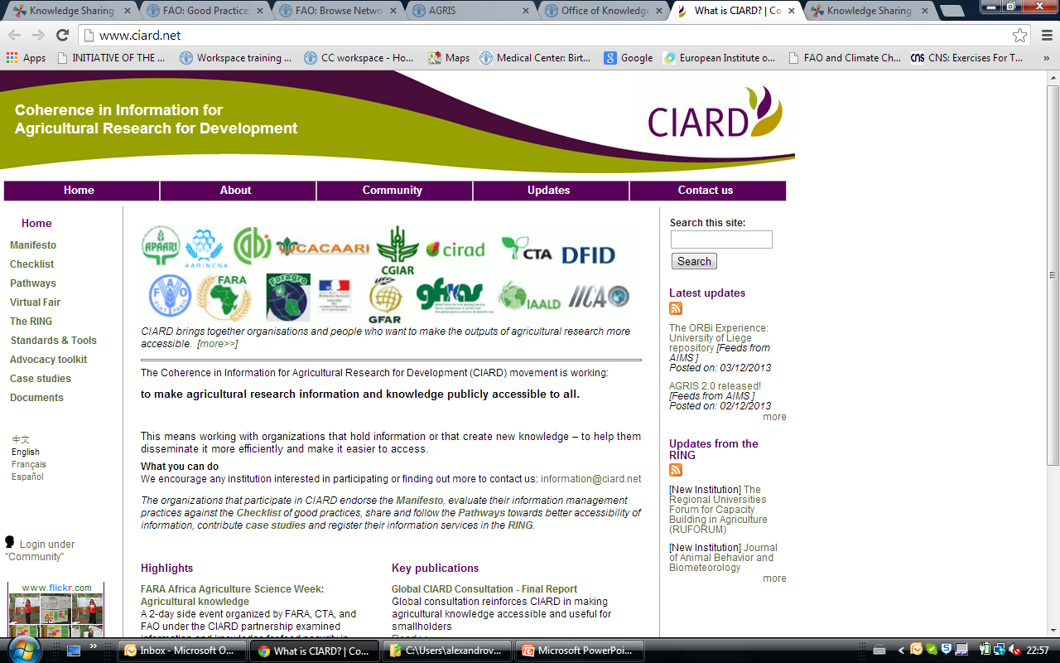

Slide 20
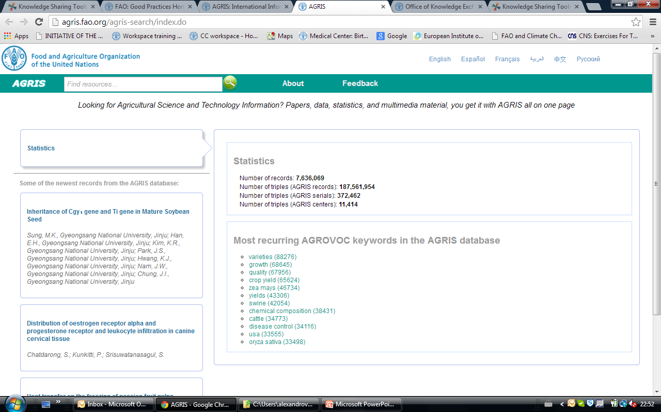
Notes:
AGRIS is a global public domain database with approximately three million structured bibliographical records on agricultural science and technology, mostly from scientific journals. The bibliographic references contain either links to the full text of the publication or additional information retrieved from related Internet resources

Slide 21
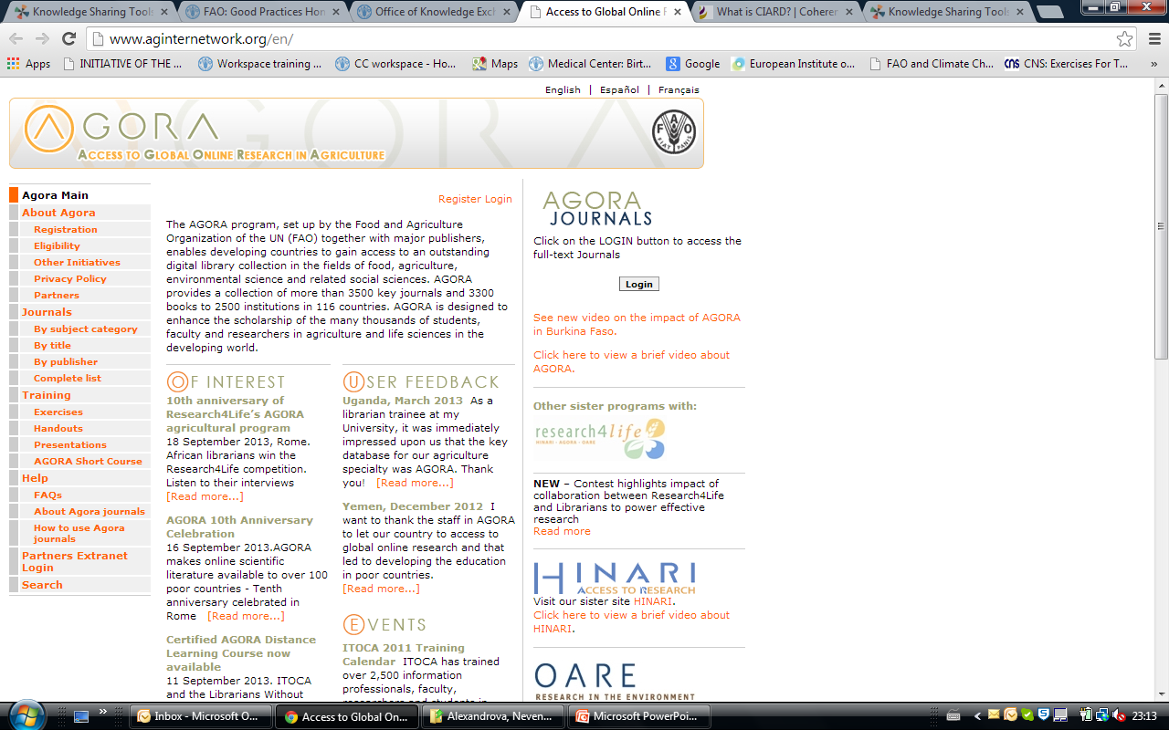

Slide 22
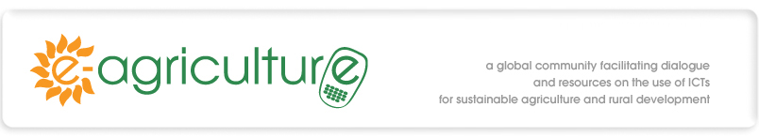
e-Agriculture is a global Community of Practice, where people from all over the world exchange information, ideas, and resources related to the use of information and communication technologies (ICT) for sustainable agriculture and rural development.
e-Agriculture: looking back and moving forward
communication and decision making in rural areas through the application of new technologies.
JOIN CURRENT FORUM http://www.e-agriculture.org/

Slide 23
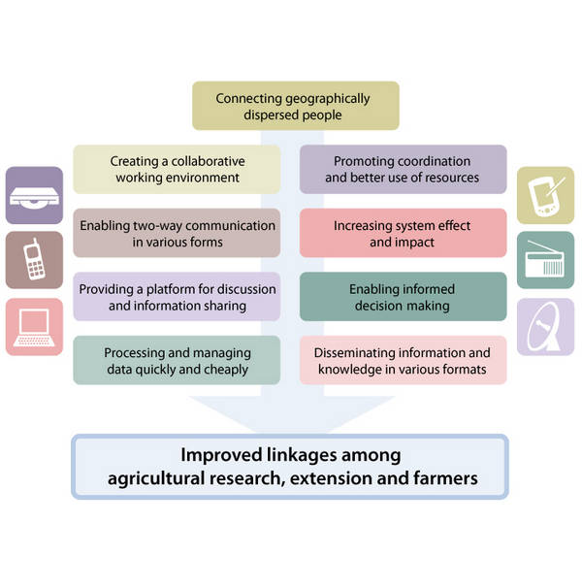
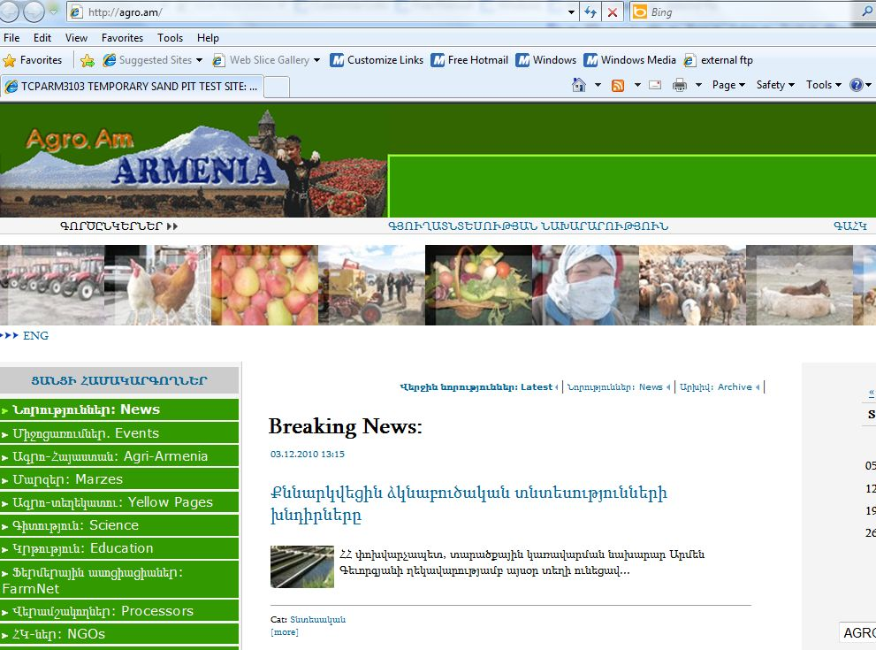
ARMENIA:
Virtual Extension and Research Communication Network (VERCON) 2009-2010 www.agro.am

Slide 24


Slide 25
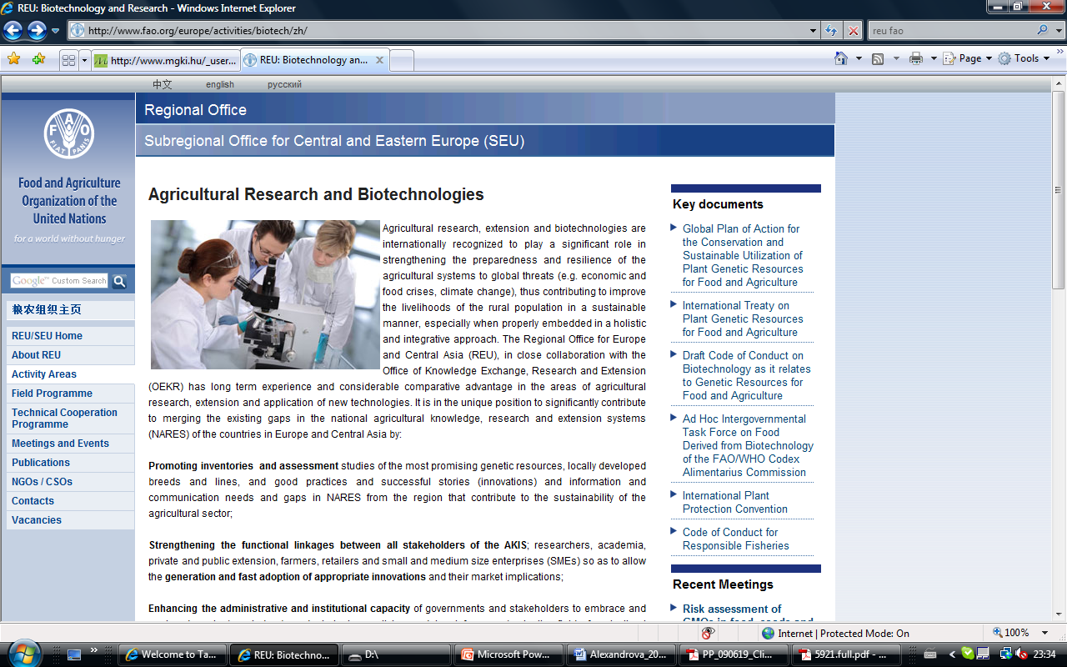
http://www.fao.org/europe/activities/biotech/zh/
Email: nevena.alexandrova@fao.org

Slide 26
Take – home messages
Knowledge is much more than raw information
In the new economic and environmental realities, strengthening collaboration between different stakeholder groups to innovate brings economic, social or environmental value
Sharing knowledge is a prerequisite for partnerships and collaboration
FAO is assisting countries with advice, initiatives and tools…

Slide 27
