Slide 1
The Global Forum on Food Security and Nutrition
www.fao.org/fsnforum
Linking practice and innovation to policy through online consultations
Gödöllö, 4 December 2013
Max F. Blanck
FSN Forum Facilitator, FAO

Slide 2
The FSN Forum
The FSN Forum is a online platform for knowledge sharing on food security, nutrition and agricultural issues.
Aims:
Better and more informed food security governance processes at global, national and regional level
Increased understanding and recognition of Food and Nutrition Security as part of the global policy agenda
Incorporation of a wider number of stakeholders views into food security governance and drafting processes.
Support of innovative thinking and multidisciplinary approaches.

Slide 3

The Forum in Numbers
Founded in 2007
4800 members from 170 countries
95 online discussions to date
10 thematic consultations
Languages
Website available in English, French and Spanish.
Comments accepted in Arabic, Chinese, English, French, Russian and Spanish

Slide 4










Structure of Membership
Africa 24%
Asia 19%
Europe 23%
LAC 14%
Near East 6%
North America 12%
Southwest Pacific 2%
Technical cooperation 2%
Government 9%
Private Sector 9%
NGO/CSO 22%
UN/intergovernmental organizations 19%
Financial Institutions 1%
Academic/Research bodies 32%
Partnerships 2%
Independent/other 4%

Slide 5
The Mechanism of Knowledge Sharing
Online discussions
Nurturing the community, exchanging knowledge , finding solutions
Policy-driven consultations
Making FS policy and drafting processes more inclusive
Targeted and regional dialogues and webspaces
Responding to specific needs of projects, offices and existing networks
Surveys
Designing and launching stakeholder surveys on behalf of partners
Network building
Building up and consolidating stakeholder networks
Integration of online and face-to-face exchanges
Linking with stakeholders on the ground

Slide 6
How a Forum Discussion Works
Interested Member/ Team contacts FSN Forum
Topic note and questions are developed. FSN Team assists
Discussion page is created
Discussion is launched for 3/4 weeks
FSN Team provides the advertisement and moderation
Digest with latest comments are sent out
Summary, brief, handout is prepared
Feedback is collected

Slide 7
Tools Used
Online Forum (Drupal platform)
Setup of dedicated thematic/regional discussions spaces
Mailing list (Listserv)
FAO Intranet
Social Media (Facebook, Twitter, LinkedIn)
Cross posting and advertisement on other platforms

Slide 8
Topics covered
Smallholders
Food systems and governance
Women in agriculture
Forestry
Fisheries
Social protection
Climate change
Mainstreaming nutrition
Indigenous knowledge
Right to Food (policy issues)
Global initiatives towards food security
Food waste
Street foods

Slide 9

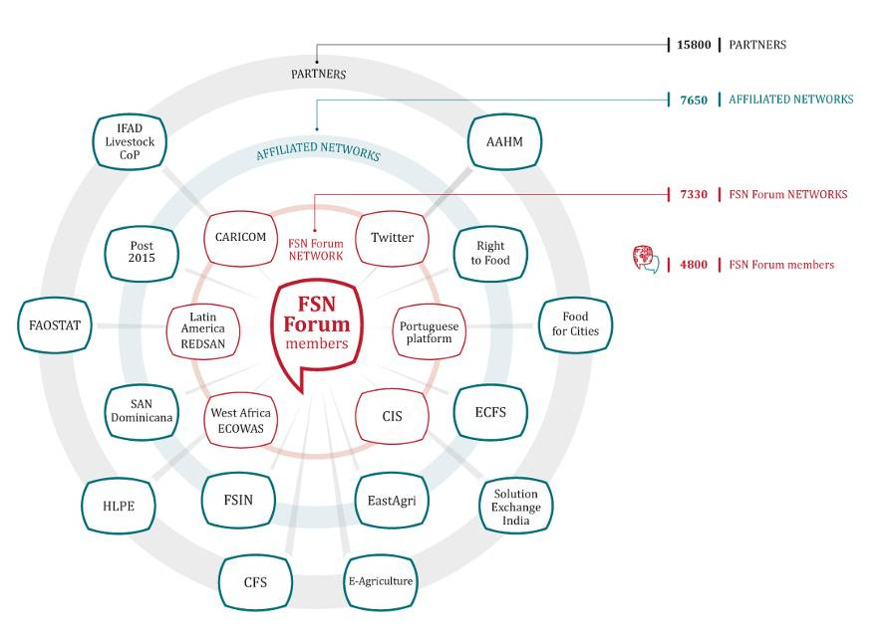
Partners & Networks

Slide 10
Post 2015 Development Agenda
Discussion with CFS Stakeholders
E-consultation to brainstorm on
new agenda
High Level meeting in Madrid
Adoption of post 2015 global development agenda
UN General Assembly Discussion

Slide 11
High Level Panel of Experts of the CFS
HLPE
Review
to set the track
Preparation of draft report
Proposed
Scope
Recommendations to countries
Project
Team
Seek suggestions and inputs
CFS 2014
Draft report
Preparation
of final report

Slide 12
Food Security Action Plan
for the Caribbean
CARICOM
Gather views and inputs
of key regional CSOs
Final Action Plan
Draft document
CARICOM
Meeting of Ministers
Country Implementation
Approved Action Plan

Slide 13
Food Security Law for the
Dominican Republic
Enact Legislation
Dominican Government
Online Consultation
Draft to be presented to Parliament
Draft Law
Physical consultation meetings facilitated by CSOs
Villages

Slide 14
Regional Forum
Regional Forums benefit from FSN Forum infrastructure, experience and existing membership but focus on regional issues and have their own target audience. Cross-feeding happens to increase global – regional dialogue.
Global FSN Forum
Regional Forum 2
West Africa
Regional audience
Global audience
Regional audience
14

Slide 15
Thank you
For further information contact us at:
fsn-moderator@fao.org
and visit our website:
www.fao.org/fsnforum

